Slide 1
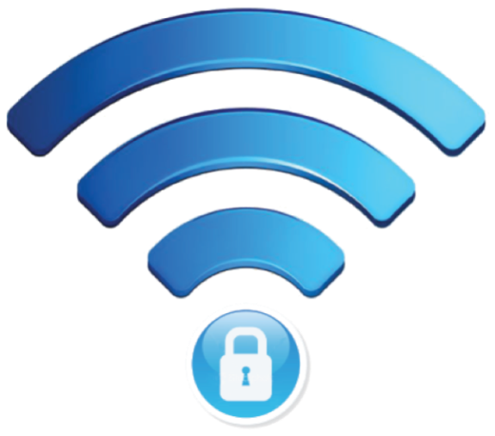
Wireless Security
An introduction to Wi-Fi™ technology and how to protect yourself at home and on the go.

Slide 2
After completing this workshop you will have learned the following:
What is Wi-Fi™ ?
What do I need to be able to use Wireless Internet?
How does Wi-Fi™ communicate with my equipment?
Common Wi-Fi™ security practices.
Mistakes almost everyone makes with setting up Wi-Fi™.
How to prevent or correct current security vulnerabilities that may exist on your network at home or at work.
How to protect yourself on “Public” Wi-Fi™
Proper settings to keep your self safe while on unsecured “Free Wi-Fi™” access points.

Slide 3
“People are probably most familiar with using Wi-Fi as a way to connect to the Internet, since for most people it’s the network they use at home or at work” Wi-Fi Alliance CEO Edgar Figueroa.
Initially developed as a way to replace your Ethernet cable — Wi-Fi is a popular technology that provides interconnectivity between devices.
Wi-Fi currently carries more than 60% of the world’s Internet traffic. Interestingly enough, this great achievement is basically done with radio waves, Wi-Fi is essentially two radios communicating back and
forth that use lower power and broadcast over much shorter distance.
These two radios let web users download data from the Internet as well
as upload information at the same time. Also important to note is that Wi-Fi primarily operates on 2 separate bands, 2.4_{Ghz} and 5_{Ghz}.
(There is also a 3.7_{Ghz} band which requires licensing and highly specialized equipment that is not relevant to this workshop)

Slide 4
Frequency Bands for Wi-Fi™
2.4 _{Ghz}
Pros :
Has a wider signal coverage area.
Better Penetration through walls and physical barriers.
Can be used by almost all Wi-Fi enabled devices.
Cons :
Since most Wi-Fi traffic is on this band, it can lead to interference and loss of signal quality.
Other electronics like microwaves, Bluetooth devices, & cordless phones can further reduce signal.
Only 13 channels within the entire band for use by consumers.
5 _{Ghz}
Pros :
Few devices support 5_{Ghz} so much less congestion on the network, less interference from other sources.
Has 23 “non-overlapping” channels for consumer use.
Supports higher speeds than 2.4_{Ghz} bands.
Cons :
Older devices can not support the 5_{Ghz} spectrum.
Poor penetration power with walls and barriers.
Modern radar units will cause interference and can block networking.

Slide 5
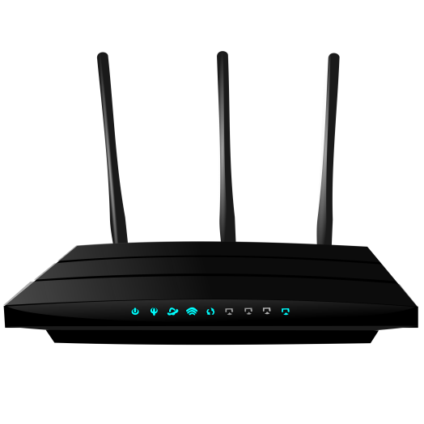
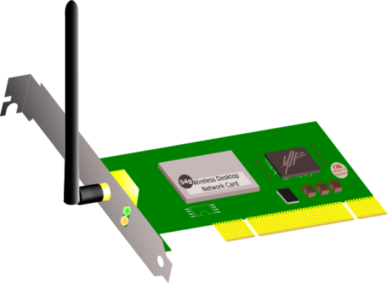
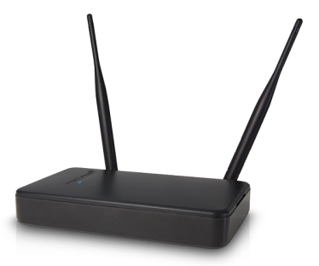
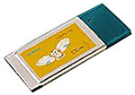
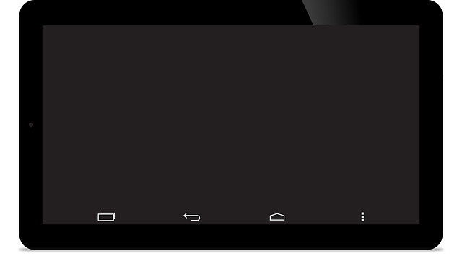
What equipment is needed to utilize Wi-Fi™ technology?

Slide 6
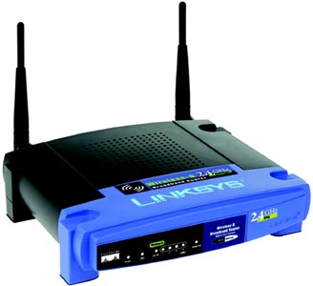
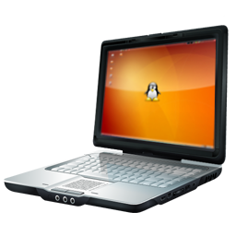
How Does Wi-Fi™ Communicate With My Equipment?
A computer's wireless network adapter converts data from 1’s and 0’s into radio signals, transmitting them via an antenna.
A wireless router or access point, receives the signals and converts them back into data in the form of electrical pulses. Those pulses are then sent out to and received back from the Internet using a physical, wired Ethernet connection.
The process also works in reverse, with the router/access point receiving information from the Internet, translating it into a radio signal and sending it to the computer's wireless adapter.

Slide 7
Common Wi-Fi™ Security Mistakes
Rented or Owned – Change your default admin password!
Most people regardless of renting from their ISP* or buying one from the store, never bother to change the default settings for their router. Priority one, should be changing your default login info to limit who can access the settings for your wireless network device.
“I forget passwords, I will just hide my SSID* so people can’t find me”
For good reason, many people think “Out of Site, Out of Mind” when it comes to their wireless network. The problem with this, is they also think that there is no reason to secure their network since no one can see their Wi-Fi™. The cold truth is that hiding your SSID* doesn’t really work the way you think it does and your (Unsecured) Wi-Fi™ can be discovered easily by an experienced war-driver*.
“I don’t understand all these security choices, I will just pick one”
On the next few slides we will briefly touch on the wireless security options and you will come to understand why it is absolutely critical to make an informed choice on which security protocol you should deploy on your network.

Slide 8
Wireless Network Security Modes
OPEN
This mode has NO security. It is considered an unsecured Wi-Fi™ connection.
WEP - Wired Equivalent Privacy
The Wi-Fi Alliance officially retired WEP in 2004, it considered to be closer to NO security then it is to being secure. As a means to raise awareness about its vulnerability the FBI gave a public demonstration where they cracked WEP passwords in minutes using freely available software.
WPA / WPA2 - Wi-Fi Protected Access revision 1 and 2
Wi-Fi Protected Access was the Wi-Fi Alliance’s direct response and replacement to the increasingly apparent vulnerabilities of the WEP standard. It was formally adopted in 2003, a year before WEP was officially retired. WPA has, as of 2006, been officially superseded by WPA2. One of the most significant changes between WPA and WPA2 was the mandatory use of AES algorithms and the introduction of CCMP (Counter Cipher Mode with Block Chaining Message Authentication Code Protocol) as a replacement for TKIP (still preserved in WPA2 as a fallback system and for interoperability with WPA).

Slide 9
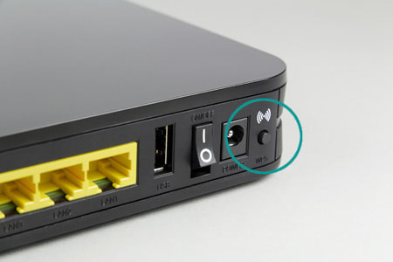
Wi-Fi™ Protected Setup (WPS) A Hidden Danger
Initially created as a means to simplify the process for connecting to your wireless network. WPS allows you to simply press a button on the router and make the connection with your device. Alternatively you can use a pin number that is provided with your router and make the connection.
While this may be easy, it also opens a huge security vulnerability that can allow even modest means hackers and script kiddies to gain unauthorized access to your network by using brute-force to attack the pin number on your router. Most SoHo routers allow you disable the feature or at least limit what it can allow someone to do. It is recommended to disable this option any time you have the ability to in order to protect your network.

Slide 10
SoHo / Personal Wireless Network Hardening Options
Regardless of where you obtained your wireless station, change the default admin login info as soon as you have it set up.
Enable encryption and choose a passphrase that is not easily guessed or part of the SSID.
If supported by your equipment, disable the WPS or Wi-Fi Protected Setup option.
Reduce the Radio Power if your equipment supports this.
If you must use the Guest Network option be sure to disable the bridge between private and guest networks.

Slide 11
FREE PUBLIC WI-FI™ (Nothing is Free!)
The same features that make free Wi-Fi™ hotspots desirable for consumers make them desirable for hackers; namely, that it requires no authentication to establish a network connection. This creates an amazing opportunity for the hacker to get unfettered access to unsecured devices on the same network.
The biggest threat to free Wi-Fi security is the ability for the hacker to position himself between you and the connection point. So instead of talking directly with the hotspot, you're sending your information to the hacker, who then relays it on.
While working in this setup, the hacker has access to every piece of information you're sending out on the Internet: important emails, credit card information and even security credentials to your business network. Once the hacker has that information, he can — at his leisure — access your systems as if he were you.
Hackers can also use an unsecured Wi-Fi connection to distribute malware. If you allow file-sharing across a network, the hacker can easily plant infected software on your computer. Some ingenious hackers have even managed to hack the connection point itself, causing a pop-up window to appear during the connection process offering an upgrade to a piece of popular software. Clicking the window installs the malware.
*Source: Kaspersky Internet Security Bulletin

Slide 12
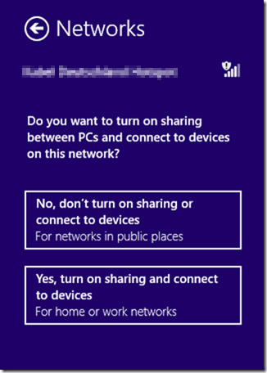
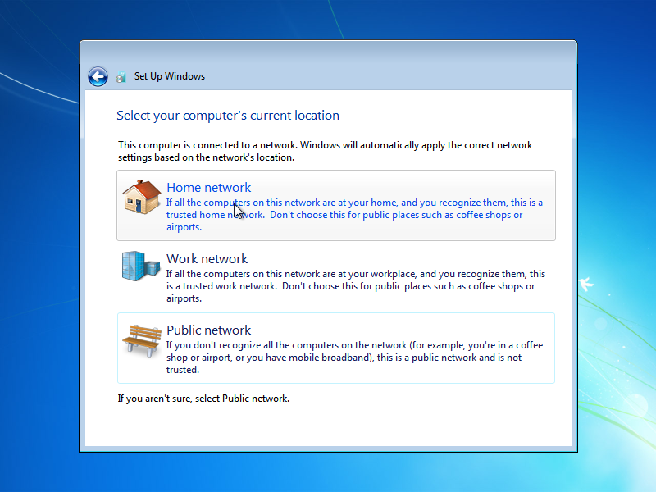
Free “PUBLIC” Wi-Fi™ The name says all you need to know!
Depending on the type of computer you are using and the operating system loaded on it, you may see one of the screens one the left when you join a public Wi-Fi™ network.
What you choose here can have a large impact on the security of your machine. If you are at a friends house, or your own home / office. It would be reasonable to assume that choosing the home or work network option would make the most sense so you can share files or take advantage of network resources.
If however, you are in a coffee shop, diner, or even your local oil change shop, ALWAYS choose public. This enables software in your computer called a “Firewall” that will help to prevent someone from getting into your computer and removing files or worse adding some of their own that you don’t want!

Slide 13
Summary and Conclusion What we have discussed
What Wi-Fi™ is, and how the technology works.
Common mistakes made when setting up wireless networking for the first time.
Vulnerabilities that exist in Wi-Fi™ technology.
Options for implementing or increasing security on your own wireless network.
Ways to protect yourself while still taking advantage of free public Wireless Hot-Spots.

Slide 14
Wireless Security
An introduction to Wi-Fi™ technology and how to protect yourself at home and on the go.

